Slide 1

Management
Fifteenth Edition, Global Edition
Chapter 2
Making Decisions

Slide 2
Learning Objectives
Describe the eight steps in the decision-making process.
Explain the five approaches managers can use when making decisions.
Classify decisions and decision-making styles.
Describe how biases affect decision making.
Identify cutting-edge approaches for improving decision making.

Slide 3
Be A Better Decision Maker
A key to success in management and in your career is knowing how to be an effective decision maker.
How do decision making affect lives?
How does decision making affect careers?
What do you look for when deciding to take a judgment on any condition or situation?
In the end are you happy with your decision?

Slide 4
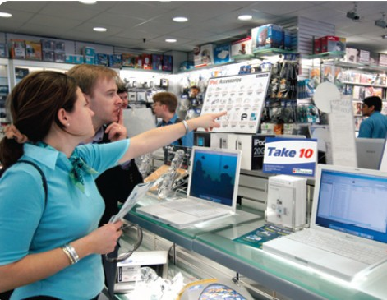
What is a Decision?
Decision—a choice among two or more alternatives

Slide 5
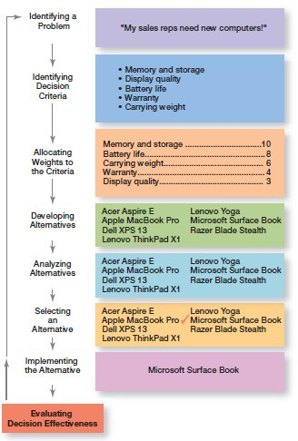
Exhibit 2.1 Decision-Making Process
Exhibit 2.1 shows the eight steps in the decision-making process. This process is as relevant to personal decisions as it is to corporate decisions.

Slide 6
Decision-Making Process Step 1: Identify a Problem
Problem: an obstacle that makes it difficult to achieve a desired goal or purpose.
Every decision starts with a problem, a discrepancy between an existing and a desired condition.
Example: Amanda is a sales manager whose reps need new laptops.

Slide 7
Decision-Making Process Step 2: Identify the Decision Criteria
Decision criteria are factors that are important to resolving the problem.
Example: Amanda decides that memory and storage capabilities, display quality, battery life, warranty, and carrying weight are the relevant criteria in her decision

Slide 8
Decision-Making Process Step 3: Allocate Weights to the Criteria
If the relevant criteria aren’t equally important, the decision maker must weight the items in order to give them the correct priority in the decision.
Example: The weighted criteria for Amanda’s computer purchase are shown in Exhibit 2.2.

Slide 9

Exhibit 2.2 Important Decision Criteria
Criterion | Weight
Memory and storage | 10
Battery life | 8
Carrying weight | 6
Warranty | 4
Display quality | 3

Slide 10
Decision-Making Process Step 4: Develop Alternatives
List viable alternatives that could solve the problem.
Example: Amanda identifies eight laptops as possible choices (shown in Exhibit 2.3).

Slide 11
Exhibit 2.3 Possible Alternatives
Laptop | Memory and Storage | Battery Life | Carrying Weight | Warranty | Display Quality
Acer Aspire E | 10 | 3 | 10 | 8 | 5
Apple MacBook | 8 | 5 | 7 | 10 | 10
Pro
Dell XPS 13 | 8 | 7 | 7 | 8 | 7
Lenovo | 7 | 8 | 7 | 8 | 7
ThinkPad
Lenovo Yoga | 8 | 3 | 6 | 10 | 8
Microsoft | 10 | 7 | 8 | 6 | 7
Surface Book
Razer Blade | 4 | 10 | 4 | 8 | 10
Stealth

Slide 12
Decision-Making Process Step 5: Analyze Alternatives Step 6: Select an Alternative
STEP 5: Once you identify the alternatives you need to analyze them using the criteria established in Step 2.
STEP 6: Choose the alternative that generates the highest total in Step 5.

Slide 13
Exhibit 2.4 Evaluation of Alternatives
Laptop Memory and Storage | Battery Life | Carrying Weight | Warranty | Display Quality | Total
Acer Aspire E 100 | 24 | 60 | 32 | 15 | 231
Apple MacBook 80 Pro | 40 | 42 | 40 | 30 | 232
Dell XPS 13 80 | 56 | 42 | 32 | 21 | 231
Lenovo 70 ThinkPad | 64 | 42 | 32 | 21 | 229
Lenovo Yoga 80 | 24 | 36 | 40 | 24 | 204
Microsoft 100 Surface Book | 56 | 48 | 24 | 21 | 249
Razer Blade 40 Stealth | 80 | 24 | 32 | 30 | 206

Slide 14
Decision-Making Process Step 7: Implement the Alternative
Put the chosen alternative into action.
Convey the decision to those affected and get their commitment to it.

Slide 15
Decision-Making Process Step 8: Evaluate Decision Effectiveness
Evaluate the result or outcome of the decision to see if the problem was resolved.
If it wasn’t resolved, what went wrong?

Slide 16
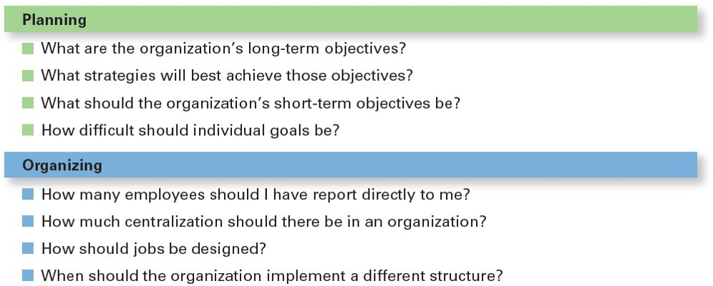
Decisions Managers May Make: Planning and Organizing

Slide 17
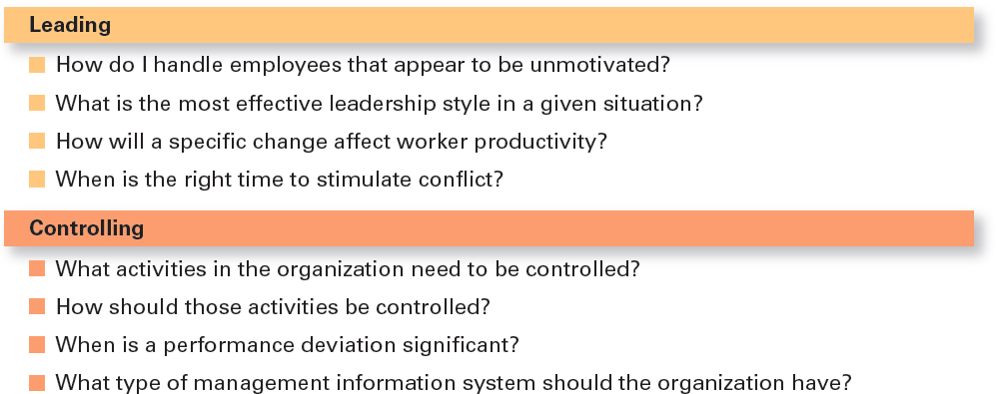
Decisions Managers May Make: Leading and Controlling

Slide 18
Rationality
Rational Decision Making: choices that are logical and consistent and maximize value
Assumptions of rationality:
Rational decision maker is logical and objective
Problem faced is clear and unambiguous
Decision maker would have clear, specific goal and be aware of all alternatives and consequences
The alternative that maximizes achieving this goal will be selected
Decisions are made in the best interest of the organization

Slide 19
Bounded Rationality
Bounded rationality: decision making that’s rational, but limited by an individual’s ability to process information
Satisfice: accepting solutions that are “good enough”

Slide 20
Intuition
Intuitive Decision Making: making decisions on the basis of experience, feelings, and accumulated judgment

Slide 21
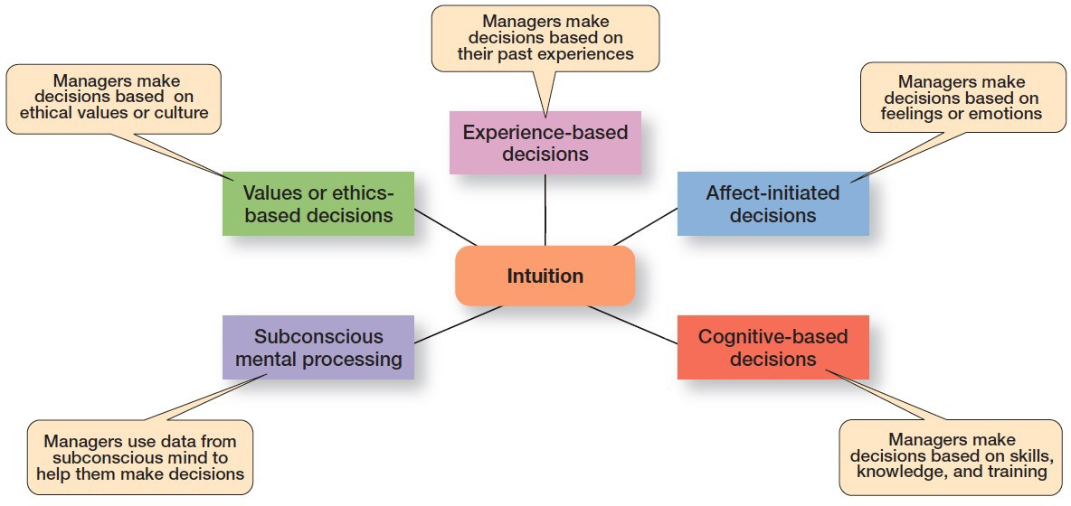
Exhibit 2.6 What is Intuition?
Exhibit 2.6 shows the five different aspects of intuition identified by researchers studying managers’ use of intuitive decision making.

Slide 22
Evidence-Based Management
Evidence-based management (EB Mgt): the systematic use of the best available evidence to improve management practice.

Slide 23
Crowdsourcing
Crowdsourcing: a decision-making approach where you solicit ideas and input from a network of people outside of the traditional set of decision makers.

Slide 24
Types of Decisions: Structured Problems and Programmed Decisions
Structured problems: straightforward, familiar, and easily defined problems
Programmed decisions: repetitive decisions that can be handled by a routine approach

Slide 25
Types of Programmed Decisions
Procedure: a series of sequential steps used to respond to a well-structured problem
Rule: an explicit statement that tells managers what can or cannot be done
Policy: a guideline for making decisions

Slide 26
Types of Decisions: Unstructured Problems and Nonprogrammed Decisions
Unstructured problems: problems that are new or unusual and for which information is ambiguous or incomplete
Nonprogrammed decisions: unique and nonrecurring and involve custom-made solutions

Slide 27
Exhibit 2.7 Programmed vs. Nonprogrammed Decisions
Characteristic | Programmed Decisions | Nonprogrammed Decisions
Type of problem | Structured | Unstructured
Managerial level | Lower levels | Upper levels
Frequency | Repetitive, routine | New, unusual
Information | Readily available | Ambiguous or incomplete
Goals | Clear, specific | Vague
Time frame for solution | Short | Relatively long
Solution relies on… | Procedures, rules, | Judgment and creativity
 | policies

Slide 28
Decision-Making Styles
Research has identified four different individual decision- making styles based on two dimensions:
An individual’s way of thinking
An individual’s tolerance for ambiguity
The four styles are directive, analytic, conceptual and behavioral.

Slide 29
Four Decision-Making Styles
Directive style: low tolerance for ambiguity and seek rationality
Analytic style: seek rationality but have a higher tolerance for ambiguity
Conceptual style: intuitive decision makers with a high tolerance for ambiguity
Behavioral style: intuitive decision makers with a low tolerance for ambiguity

Slide 30
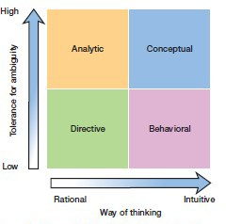
Exhibit 2.8 Decision-Style Model
Exhibit 2.8 shows the decision-style model from A. J. Rowe and J. D. Boulgarides,
Managerial Decision Making (Upper Saddler River, N J: Prentice Hall, 1992), p. 29.

Slide 31
Heuristics
Heuristics or “rules of thumb” can help make sense of complex, uncertain, or ambiguous information.
However, they can also lead to errors and biases in processing and evaluating information.

Slide 32
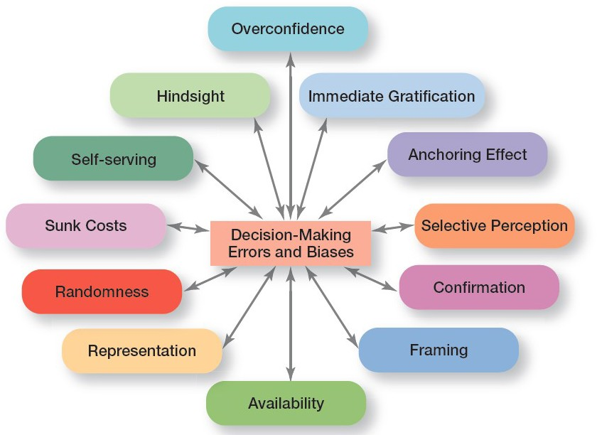
Exhibit 2.9 Common Decision-Making Biases
Exhibit 2.9 identifies 12 common decision errors of managers and biases they may have.
Notes:
Instant gratification is the immediate desire to feel satisfaction……
The anchoring effect is a cognitive bias that describes the common human tendency to rely too heavily on the first piece of information offered.
Framing….. the basic structure that surrounds and supports something…..
A sunk cost is an expense that cannot be recovered……
Handsight : understanding of a situation or event only after it has happened or developed…………
Overconfidence:the quality of being too confident; excessive confidence.
Self serving:having concern for one's own welfare and interests before those of others…………

Slide 33
Decision-Making Biases and Errors (1 of 4)
Overconfidence Bias: holding unrealistically positive views of oneself and one’s performance
Immediate Gratification Bias: choosing alternatives that offer immediate rewards and avoid immediate costs
Anchoring Effect: fixating on initial information and ignoring subsequent information

Slide 34
Decision-Making Biases and Errors (2 of 4)
Selective Perception Bias: selecting, organizing and interpreting events based on the decision maker’s biased perceptions
Confirmation Bias: seeking out information that reaffirms past choices while discounting contradictory information
Framing Bias: selecting and highlighting certain aspects of a situation while ignoring other aspects

Slide 35
Decision-Making Biases and Errors (3 of 4)
Availability Bias: losing decision-making objectivity by focusing on the most recent events
Representation Bias: drawing analogies and seeing identical situations when none exist
Randomness Bias: creating unfounded meaning out of random events

Slide 36
Decision-Making Biases and Errors (4 of 4)
Sunk Costs Errors: forgetting that current actions cannot influence past events and relate only to future consequences
Self-serving Bias: taking quick credit for successes and blaming outside factors for failures
Hindsight Bias: mistakenly believing that an event could have been predicted once the actual outcome is known (after-the-fact)

Slide 37
Cutting-Edge Decision Making
Technology has changed the ability of managers to access information. Two technology driven cutting-edge aides to decision making are:
Design thinking: approaching management problems as designers approach design problems
Big data and Artificial Intelligence: big data refers to huge and complex data sets now available. Big data has opened the door to widespread use of artificial intelligence (A I)

Slide 38
Big Data and Artificial Intelligence
Big data: the vast amount of quantifiable data that can be analyzed by highly sophisticated data processing
Can be a powerful tool in decision making, but collecting and analyzing data for data’s sake is wasted effort

Slide 39
Artificial Intelligence and Machine Learning Tools
Artificial Intelligence (A I) – uses computing power to solve complex problems
A I systems have the ability to learn and have facilitated the use of new tools such as:
Machine learning
Deep learning
Analytics

Slide 40
Machine Learning, Deep Learning, and Analytics
Machine Learning: A method of data analysis that automates analytical model building.
Deep Learning: A subset of machine learning that use algorithms to create a hierarchical level of artificial neural networks that simulate the function of the human brain.
Analytics: The use of mathematics, statistics, predictive modeling, and machine learning to find meaningful patterns in a data set.

Slide 41
Review Learning Objective 2.1
Describe the eight steps in the decision-making process.
Identify problem
Identify decision criteria
Weight the criteria
Develop alternatives
Analyze alternatives
Select alternative
Implement alternative
Evaluate decision effectiveness

Slide 42
Review Learning Objective 2.2 (1 of 2)
Explain the five approaches managers use when making decisions.
Assumptions of rationality
The problem is clear and unambiguous
A single, well-defined goal is to be achieved
All alternatives and consequences are known
The final choice will maximize goal achievement

Slide 43
Review Learning Objective 2.2 (2 of 2)
Rationality: making decisions when the goal is well- defined and everything is clear and unambiguous
Satisficing: when decision makers accept solutions that are good enough
Intuitive decision making: making decisions on the basis of experience, feelings, and accumulated judgment
Evidence-based management: a manager makes decisions based on the best available evidence
Crowdsourcing: a manager solicits ideas via the internet from people outside of the organization

Slide 44
Review Learning Objective 2.3 (1 of 2)
Classify decisions and decision-making styles.
Programmed decisions are repetitive decisions that can be handled by a routine approach and are used when the problem being resolved is straightforward, familiar, and easily defined (structured).
Nonprogrammed decisions are unique decisions that require a custom-made solution and are used when the problems are new or unusual (unstructured) and for which information is ambiguous or incomplete.

Slide 45
Review Learning Objective 2.3 (2 of 2)
Classify decisions and decision-making styles.
Individual decision-making styles differ on two dimensions; way of thinking and tolerance for ambiguity.
These dimensions result in four different decision- making styles which are:
Directive
Analytical
Conceptual
Behavioral

Slide 46
Review Learning Objective 2.4
Describe how biases affect decision making.
The 12 common decision-making errors and biases:
Overconfidence
Immediate gratification
Anchoring effect
Selective perception
Confirmation
Framing
Availability
Representation
Randomness
Sunk costs
Self-serving
Hindsight

Slide 47
Review Learning Objective 2.5 (1 of 2)
Identify cutting-edge approaches for improving decision making.
– Design thinking, big data, artificial intelligence, machine learning, deep learning, and analytics are all relatively new tools that harness the power of technology to help managers make better decisions.

Slide 48
Review Learning Objective 2.5 (2 of 2)
Design thinking: approaching management problems as designers approach design problems
Big Data: when tempered with good judgment, it can be a powerful tool in decision making
Artificial Intelligence: AI and the tools that use AI are now possible due to big data and computing power. Machine learning, deep learning, and analytics can all help managers make better decisions.

